Slide 1
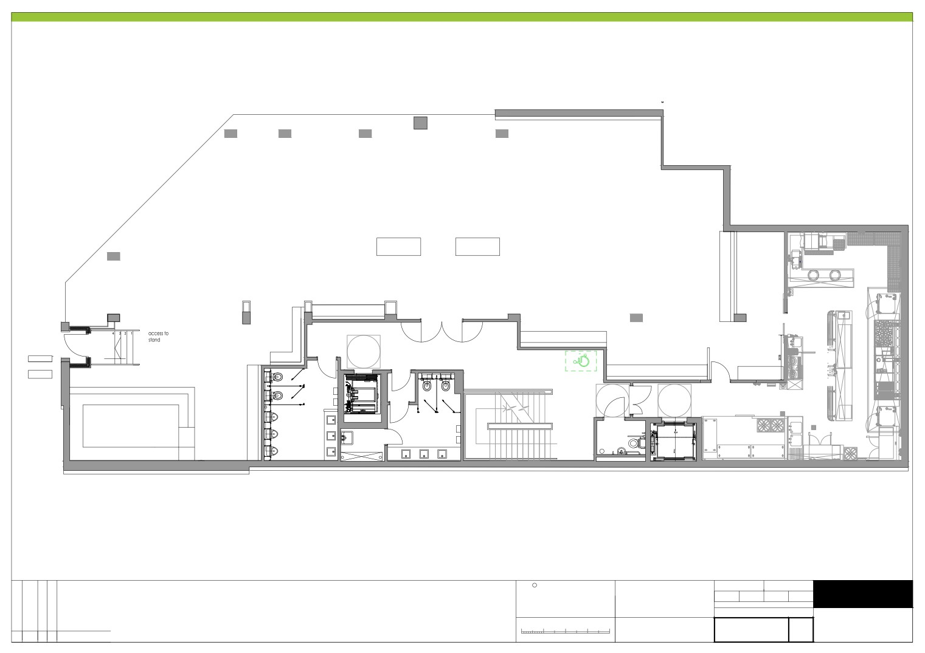
 7KLV GUDZLQJ LV WKH SURSHUW\ RI &0, :25.3/$&( DQG PXVW QRW EH FRSLHG RU UHSURGXFHG LQ IXOO RU LQ SDUW ZLWKRXW H[SUHVV ZULWWHQ SHUPLVVLRQ '2 127 6&$/( 8VH ILJXUHG GLPHQVLRQV RQO\ $OO GLPHQVLRQV WR EH YHULILHG RQ VLWH SULRU WR FRPPHQFLQJ FRQVWUXFWLRQ
8
9
15
16
20
21
22
25
27
26
7
14
23
24
26
31
32
5
10
17
18
5
42
6
13
34
4
29
30
33
3
35
1
12
36
2
39
38
D
11
37
D
40
Entrance: 1;2

